Slide 1
WATERFALL VS. Scrum-Agile
SLIDE
INFO
SLIDE INFO PAGE
SLIDE #2 – TITLE PAGE – WATERFALL VS. SCRUM AGILE
SLIDE #3 – SCRUM AGILE TEAM ROLES
SLIDE #4 – SDLC PHASES IN AGILE
SLIDE #5 - WATERFALL VS AGILE
SLIDE #6 – WHICH METHOD TO CHOOSE?
REFERENCES PAGE
Week 7 - Final Presentation By Jaden B. Knutson
CS-250 – Comparison Overview for ChadaTech
12/6/23 – 8:11 am
Notes:
SLIDE #1 – SLIDE INFO PAGE:
*JUST SLIDE INFO*

Slide 2

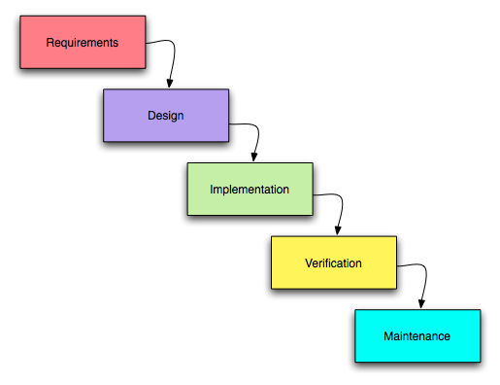
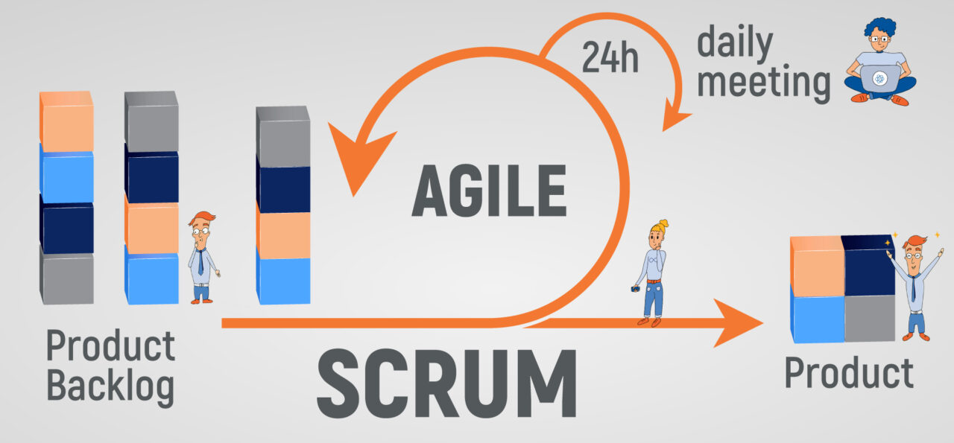
WATERFALL VS. Scrum-Agile
The Traditional Waterfall Approach (umsl.edu)
Agile software development with Scrum (kruschecompany.com)
Waterfall Method
Scrum-Agile Method
Week 7 - Final Presentation By Jaden B. Knutson
CS-250 – Comparison Overview for ChadaTech
12/6/23 – 8:11 am
Notes:
SLIDE #2 – TITLE PAGE – WATERFALL VS. SCRUM AGILE:
Hello, and welcome to my presentation on whether we should consider keeping the Waterfall Method or switching to a Scrum Agile methodology.

Slide 3
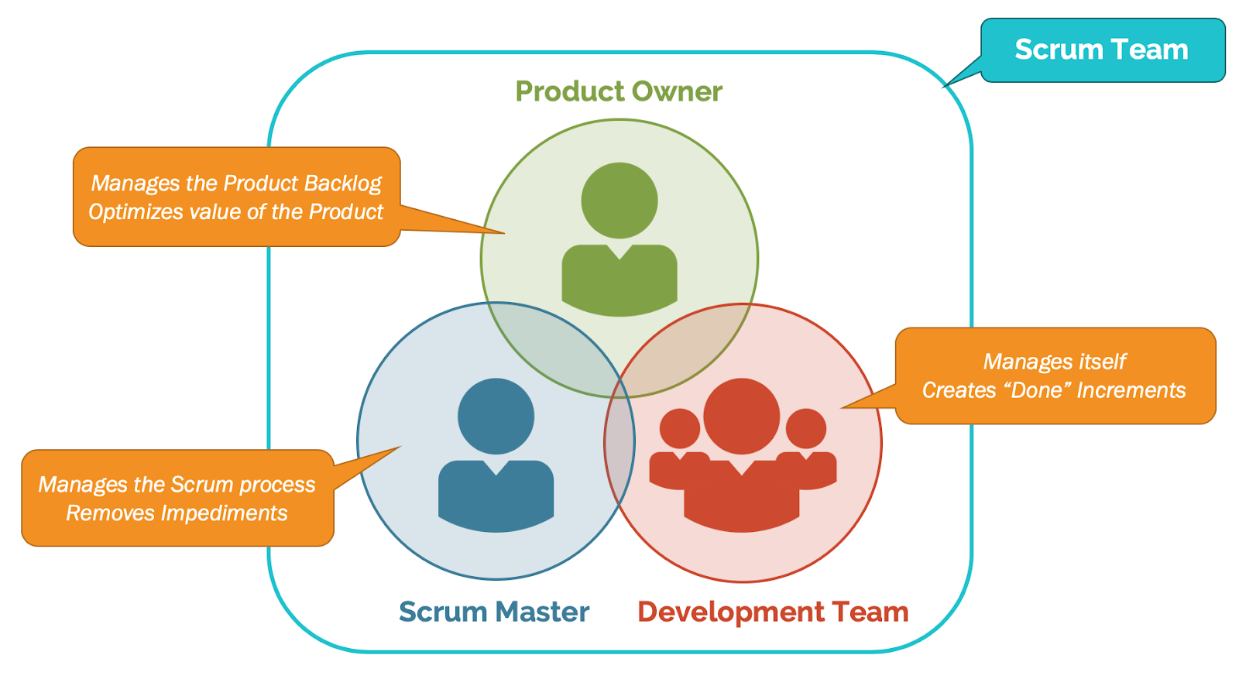
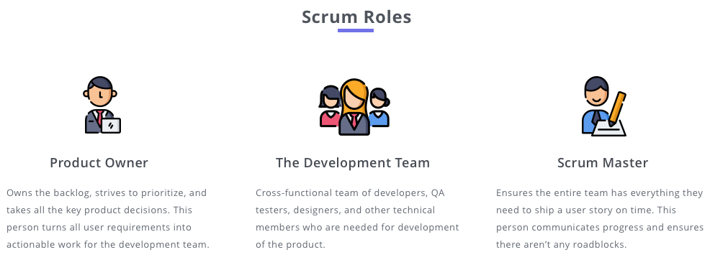
Scrum-agile team: roles
What Are The Complete Scrum Artifacts? - Agile - ZenTao
PRODUCT OWNER:
Defines project needs and requirements
Manages user stories and backlog
Aligns team with stakeholder goals
SCRUM MASTER:
Organizes Scrum events
Aids with developer challenges
Ensures Agile practice adherence
DEVELOPERS:
Builds program features
Helps with user stories and backlog
Implements user story requirements
TESTERS:
Ensures product quality
Provides developmental feedback
Participates in story refinement
What Are The Complete Scrum Artifacts? - Agile - ZenTao
Notes:
SLIDE #3 – SCRUM AGILE TEAM ROLES: Explain the various roles on a Scrum-agile Team by identifying each role and describing its importance.
Product Owner:
The Product Owner defines and drives the project vision for the program.
The Product Owner aims to make a bridge of understanding between the development team and the hopes of users and stakeholders.
By using feedback and insight from the users and stakeholders, the Product Owner can properly incorporate and manage the user stories and backlog for the team.
Doing this helps define the goals and tasks for the project, along with their difficulty of completion and priority level.
This also ensures the team works on the most relevant and valuable features.
Scrum Master:
The Scrum Master is responsible for setting up Scrum events and helping the team follow and embrace agile principles.
The Scrum Master also acts as the team's coach for developmental challenges, enhancing the team's effectiveness and efficiency.
Developers:
The Developers work closely with the Scrum Master, Product Owner, and Testers to develop a program that meets the requirements of stakeholders and users.
The Developers help the Product Owner with user stories and backlog refinement and collaborate with testers to define risks and acceptance metrics.
Testers:
The Testers test the program and ensure that the program works as intended and report back to the development team with the results.
This frequent feedback ensures the program and features are working and that the implementation follows the user stories' required needs.
Testers can also help with user stories, gaining a better understanding of desired results and gaining a better insight into the possible acceptance metrics.

Slide 4
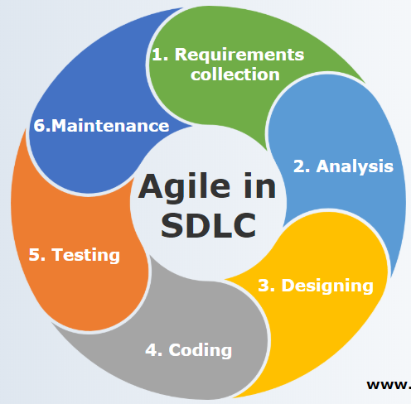

Sdlc phases in agile
1. REQUIREMENTS:
Gather user needs
Create user stories
2. DESIGN:
Plan UI/UX
Architect system
3. DEVELOPMENT:
Code features
Iterative sprints
4. TESTING:
Quality assurance
User story validation
5. TESTING:
Release to users
Continuous delivery
Agile in SDLC | Characteristics and Functionality of Agile in SDLC (educba.com)
Notes:
SLIDE #4 – SDLC PHASES IN AGILE:
Explain how the various phases of the SDLC work in an agile approach. Be sure to identify each phase and describe its importance.
Requirements Phase:
The requirement phase starts with the Project Owner (and possibly some other roles) deciphering and collecting the stakeholders' and users' goals, requirements, needs, and expectations.
These desired features and goals are then broken down into user stories, identifying the needed features and sorting them in the backlog by difficulty and priority.
Design Phase:
The design phase comes after and is where the team starts designing the framework, features, and overall concept of how the program will work to aid in the development process.
Development Phase:
The development phase is where the developers implement the designs and strategies from the design phase, often in iterative cycles called sprints, each resulting in a progressive increment to the end goal.
Testing Phase:
The testing phase is where the testers test the program increments and ensure everything is working and aligned with the defined success and acceptance criteria.
Deployment:
Lastly is the deployment phase, where we deploy the working feature or program to the stakeholders, users, or public.
This is usually done incrementally to receive feedback and improve our previous designs or implementations.

Slide 5
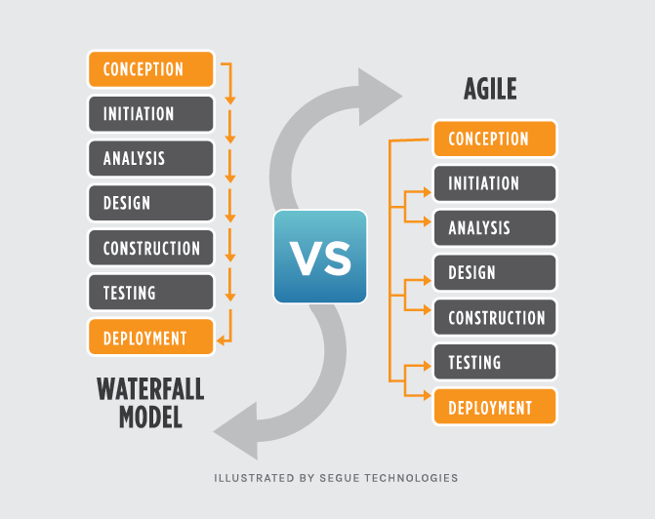

WATERFALL VS. AGILE
Sequential vs. Iterative:
Waterfall is linear
Agile allows for iteration
Feedback Integration:
Agile enables continuous feedback
Waterfall does not
Change Management:
Agile supports change throughout the project
Waterfall is rigid
Example:
UI redesign feedback could be swiftly implemented in Agile
UI redesign could be costly in Waterfall
Waterfall vs. Agile: Which Methodology is Right for Your Project? (seguetech.com)
Notes:
SLIDE #5 - WATERFALL VS AGILE:
Describe how the process would have been different with a waterfall development approach rather than the agile approach you used. For instance, you might discuss how a particular problem in development would have proceeded differently.
In a traditional Waterfall model, we would approach the project in a linear, sequential phase.
Requirements would be gathered in full at the beginning, and once the development phase starts, going back to make changes will be difficult and costly.
For example, let's say that we get negative feedback toward the project's completion and have to redesign and implement a new user interface for the program.
In a Waterfall model, this would lead to many changes requiring us to revisit and alter work that we had considered complete, impacting our timeline and budget significantly.
In contrast, the Agile approach allows us to integrate feedback immediately in our next sprint, making the change process more manageable and less disruptive to the project's completion.

Slide 6

WHICH METHOD TO CHOOSE?
1,600+ Tug Of War Stock Illustrations, Royalty-Free Vector Graphics & Clip Art - iStock | Tug of war business, Competition, Dog tug of war (istockphoto.com)
Project Complexity:
Agile for evolving requirements
Waterfall for well-defined scope
Client Involvement:
Agile for active client participation
Waterfall for less frequent interaction
Time to Market:
Agile for faster releases
Waterfall for fixed schedules
Risk Management:
Agile manages risks in a continuous, iterative, flexible order
Waterfall manages risks in a linear, sequential, nonflexible order
Team Dynamics:
Agile requires a collaborative team
Waterfall can work with a more siloed structure
Notes:
SLIDE #6 – WHICH METHOD TO CHOOSE?:
Explain what factors you would consider when choosing a waterfall approach or an agile approach, using your course experience to back up your explanation.
Which method to choose can come down to a range of factors. Is the project complex?
The Agile method would be the best option for increasingly complex projects with evolving requirements.
Waterfall would be best in projects with a well-defined scope and without much flexibility.
For increased client and stakeholder involvement, Agile would be the best option.
The waterfall would be better if there were less frequent interaction required.
For increased risk management, Agile is the best for its ongoing assessment and adaptability to changes.
Waterfall’s approach is more linear, and is assessed in a sequential, nonflexible order.
Agile focuses on a collaborative team-driven environment, where the waterfall method can lead to siloes and a more isolated environment.
Overall, Agile shows many attractive key points to its methodology, especially when Agile tends to have faster releases, increased team collaboration, and a higher chance the overall product meets the needs and requirements of users and stakeholders alike.

Slide 7
References PAGE:
JIRA REFERENCES:
Atlassian. (2019). Jira Cloud. Atlassian. https://www.atlassian.com/software/jira
The Project Managers Guide to Mastering Agile(2023). Snhu.edu. https://web-sebscohost.com.ezproxy.snhu.edu/ehost/ebookviewer/ebook/bmxlYmtfXzkzNzAwOV9fQU41?sid=1b8b185f-6752-4d65-8600-a8e609e0d27d@redis&vid=0&format=EB&lpid=lp_151&rid=0
‌ Atlassian. (n.d.). Jira Software vs Azure DevOps. Atlassian. Retrieved December 4, 2023, from https://www.atlassian.com/software/jira/comparison/jira-vs-azure-devops
SCRUM EVENTS AND PRINCIPLES REFERENCES:
‌ Schwaber, K., & Sutherland, J. (2020, November). Scrum Guide | Scrum Guides. Scrumguides.org. https://scrumguides.org/scrum-guide.html
‌ Overeem, B. (2016). Characteristics of a Great Scrum Team. https://scrumorg-website-prod.s3.amazonaws.com/drupal/2016-08/Characteristics%20of%20a%20Great%20Scrum%20Team.pdf
CS250-Module Two: Initial Client Meeting. (n.d.). Snhu-Media.snhu.edu. https://snhu-media.snhu.edu/files/course_repository/undergraduate/cs/cs250/storyline/mod2/story_html5.html
Agile Team Charter Template. (2018). Live.com. https://view.officeapps.live.com/op/view.aspx?src=https%3A%2F%2Fwww.projectmanagementdocs.com%2Fwp-content%2Fuploads%2F2018%2F07%2FAgile-Team-Charter.docx&wdOrigin=BROWSELINK
(n.d.). Login.microsoftonline.com. Retrieved November 5, 2023, from https://web-p-ebscohost-com.ezproxy.snhu.edu/ehost/ebookviewer/ebook/bmxlYmtfXzkzNzAwOV9fQU41?sid=f8efbda2-cc4c-4629-aaa7-8b064192cc59@redis&vid=0&format=EB&lpid=lp_193&rid=0
Notes:
SLIDE #7 – REFERENCES:
I would like to thank you for watching my presentation, and I hope you consider using the Agile Methodology in your next project!

